Slide 1

26th biennial national convention pre-convention workshop
Mark Dimondstein, President

Slide 2


Apwu motor vehicle service craft
Michael Foster, Director
Ken Prinz, Asst Director

Slide 3

MAXIMIZATION
FULL-TIME FLEXIBLE APWU
INSTRUCTED BY:
BRUCE AMEY, nba

Slide 4
Full-Time Flexible Memorandum

Slide 5
Section 3. Employee Complements, The Employer shall staff all postal installations which have 200 or more man years of employment in the regular work force as of the date of this Agreement with 90% full-time employees. The Employer shall maximize the number of full-time employees and minimize the number of part-time employees who have no fixed work schedules in all postal installations: A part-time flexible employee working eight (8) hours within ten (10), on the same five (5) days each week and the same assignment over a six-month period will demonstrate the need for converting the assignment to a full-time position . Where a count and inspection of an auxiliary city delivery assignment indicates that conversion to a full-time position is in order, conversion will be made.
See Memorandum of Understanding, Page 141.

Slide 6
MEMORANDUM OF UNDERSTANDING
Between
United States Postal Service
and
American Postal Workers Union, AFL-CIO
National Association of Letter Carriers, AFL-CIO
National Post Office Mail Handlers, Watchmen, Messengers and Group Leaders Division of the Laborers' International Union of North America, AFL-CIO
The parties hereby commit themselves to the maximization of fulltime employees in all installations. Therefore, they agree to establish a National Joint Committee on Maximization . That Committee shall, during the first year of the 1978 National Agreement, develop criteria applicable by craft for the establishment of additional fulltime duty assignments with either regular or flexible schedules. To this end, the Committee shall develop both an approach to combining part-time flexible work hours into full-time duty assignments and a method for determining scheduling needs compatible with the creation of the maximum possible number of such assignments.
Date: September 15, 1978

Slide 7
Section 3. Employee Complements
The Employer shall staff all postal installations which have 200 or more man years of employment in the regular work force as of the date of this Agreement with 90% fulltime employees .
B . The Employer shall maximize the number of full-time employees and minimize the number of part-time employees who have no fixed work schedules in all postal installations .
C . A part-time flexible employee working eight (8) hours within ten (10), on the same five (5) days each week and the same assignment over a six month period will demonstrate the need for converting the assignment to a full-time position .
D . Where a count and inspection of an auxiliary city delivery assignment indicates that conversion to a full-time position is in order, conversion will be made . See Memo Page 166 and 169

Slide 8
ARTICLE VII MEMORANDUM OF UNDERSTANDING
Where a part-time flexible has performed duties within his craft and occupational group within an installation at least 40 hours a week (8 within 9, or 8 within 10, as applicable), 5 days a week, over a period of 6 months, the senior part-time flexible shall be converted to full-time status .
This criteria shall be applied to postal installations with 150 or more man years of employment.
It is further understood that part-time flexibles converted to full-time under this criteria will have flexible reporting times, flexible non-scheduled days and flexible reporting locations within the installation depending upon operational requirements as established on the preceding Wednesday.

Slide 9
MEMORANDUM OF UNDERSTANDING
BETWEEN
THE UNITED STATES POSTAL SERVICE AND AMERICAN POSTAL WORKERS UNION, AFL-CIO
Re: Maximization/Full-time Flexible – APWU
Where a part-time flexible has performed duties within his craft and occupational group within an installation at least 40 hours a week (8 within 9, or 8 within l0, as applicable), 5 days a week, over a period of 6 months, the senior part-time flexible shall be converted to full-time status.
This criteria shall be applied to postal installations with l25 or more man years of employment.
It is further understood that part-time flexibles converted to full-time under this criteria will have flexible reporting times, flexible nonscheduled days, and flexible reporting locations within the installation depending upon operational requirements as established on the preceding Wednesday. The parties will implement this in accordance with their past practice.
Date: July 21, 1987

Slide 10
MEMORANDUM OF UNDERSTANDING
BETWEEN
THE UNITED STATES POSTAL SERVICE AND AMERICAN POSTAL WORKERS UNION, AFL-CIO
Re: Conversions under the Maximization Memorandum
As discussed, when a full-time assignment(s) is being withheld in accordance with Article 12, the subsequent backfilling of the assignment(s) will not count towards the time considered for maximizing full-time dub assignments, in accordance with the Memorandum of Understanding.
The parties also recognize that employees are to be converted to full-time consistent with the memorandum, provided the work being performed to meet maximization qualification in not being performed on assignment(s) described above.
____________________________ __________________________
Sherry A. Cagnoli William Burrus
Assistant Postmaster General Executive Vice President
Labor Relations Department American Postal Workers
U.S. Postal Service Workers Union, AFL-CIO

Slide 11
FULL-TIME FLEXIBLE MEMORANDUM
Conversions to full-time are required when the following requirements are met:
The part-time flexible employee works at least thirty-nine hours per week during the previous six months (paid leave hours count as work hours, except where taken to round out to forty hours).
The part-time flexible employee worked practically five eight hour days each service week during the six-month period (consistent with the above thirty-nine-hour requirement).
The employee works in an office with 125 or more work years.
The part-time flexible employee was not working in a withheld position during the period.
The work was performed in the employee’s craft, occupational group and installation.

Slide 12
If a part-time flexible employee meets the above criterion, the senior part-time flexible employee must be converted to full-time flexible. Such employee has a flexible schedule which is established week-to-week and posted on the Wednesday preceding the service week. The schedule may involve varying daily reporting times, varying nonscheduled days and varying reporting locations within the installation depending on operational requirements.

Slide 13
Employees converted to full-time flexible status are considered unassigned (unencumbered in the clerk craft) full-time employees who may bid on posted duty assignments or be assigned to residual duty assignments. Full-time flexible assignments are incumbent only assignments and are not filled when vacated.

Slide 14
Note: Conversions required pursuant to the Full-Time Flexible Memorandum shall be in addition to (but not duplicative of) conversions that may be required pursuant to Article 7.3.A, B and C.

Slide 16
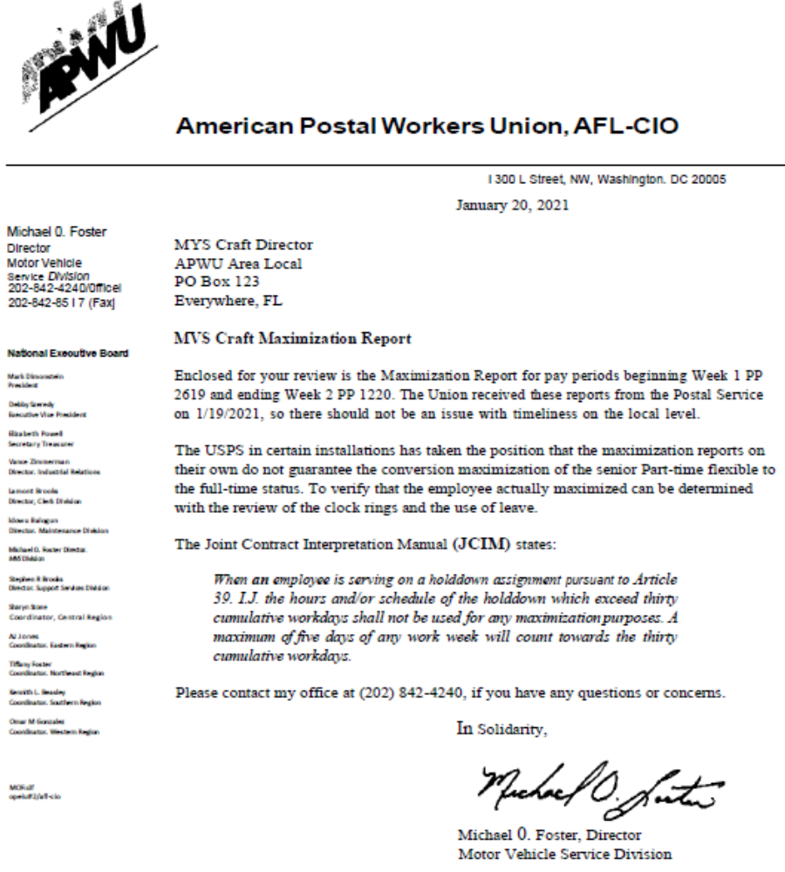

Slide 17
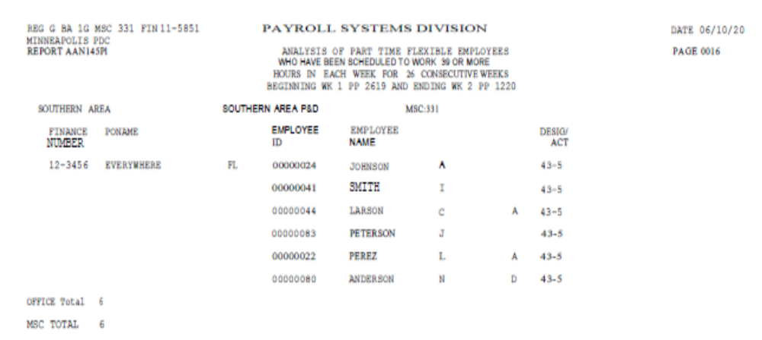

Slide 18
Documents needed to support your claim
Hours Analysis Report
Employee Everything Report
PS Form(s) 3971 – Notification of Leave Request
Weekly Reporting Schedule (Posted Wednesday’s)
Hold-Down Awards

Slide 20
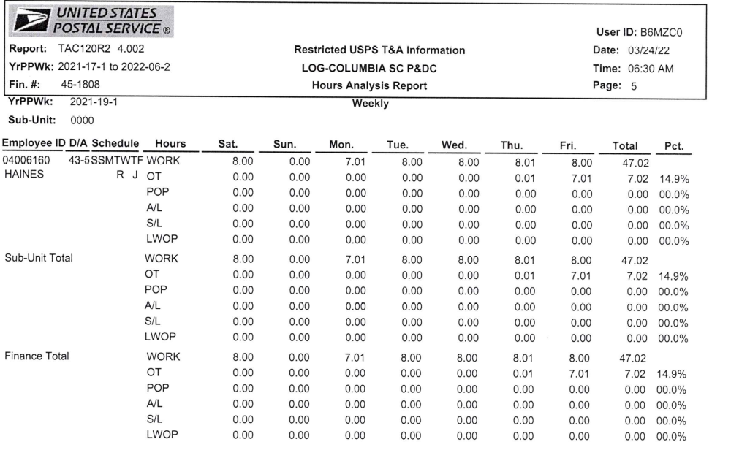

Slide 23
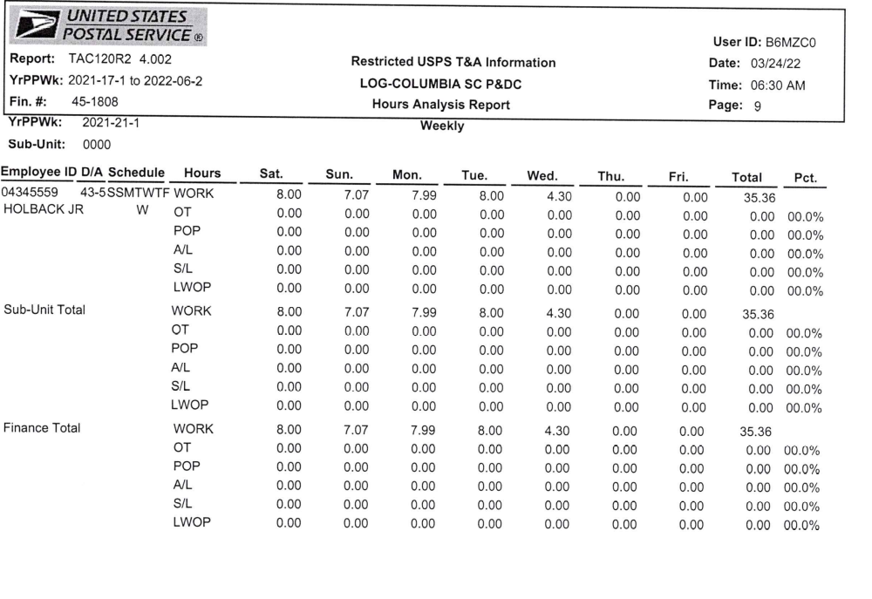

Slide 24
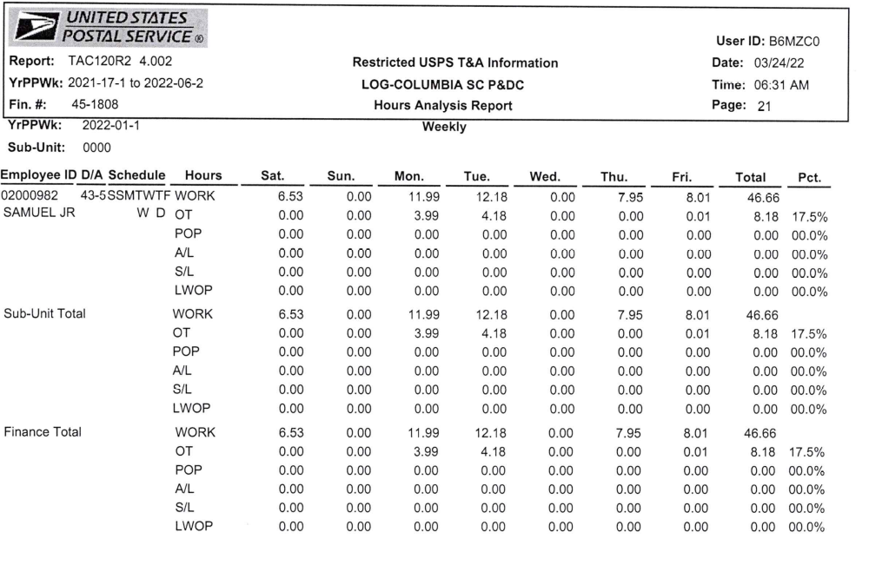

Slide 25
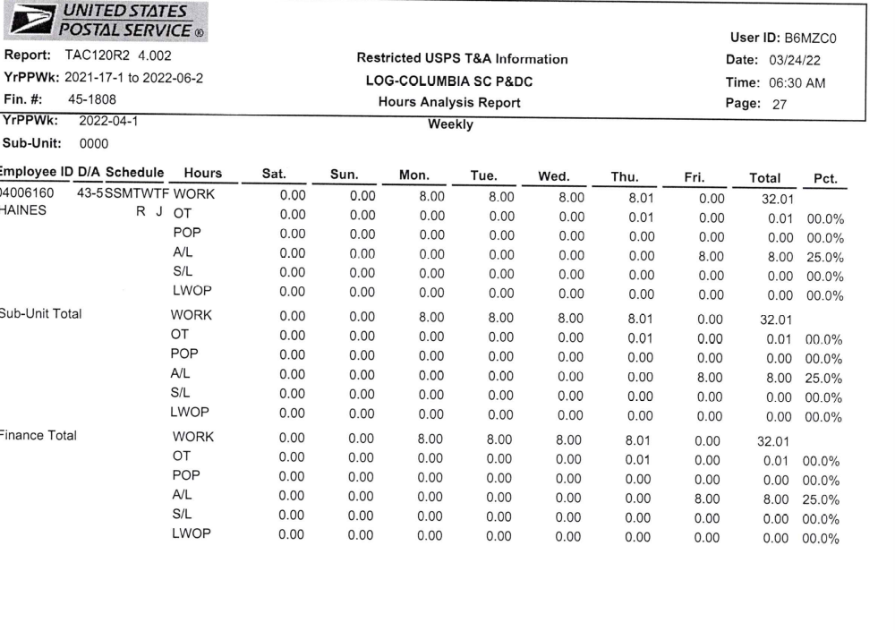

Slide 26
 | PP1 | PP2 | PP3 | PP4 | PP5 | PP6 | PP7 | PP8 | PP9 | PP10 | PP11 | PP12 | PP13
Employee A
Employee B
Employee C
Employee D
Employee E
Employee F
Employee G
Employee H
Employee I
Employee J
Employee K

Slide 27
Article 39.1.J
When an employee is serving on a holddown assignment pursuant to Article 39.1.J, the hours and/or schedule of the holddown which exceed thirty cumulative workdays shall not be used for any maximization purposes. A maximum of five days of any work week will count towards the thirty cumulative workdays.

Slide 28
MEMORANDUM OF UNDERSTANDING BETWEEN THE
UNITED STATES POSTAL SERVICE & AMERICAN POSTAL WORKERS UNION, AFL-CIO
RE: ARTICLE 39.1 .J .Temporary Holddowns Maximization
The backfilling of temporarily vacant assignment(s) described in Article 39.1 Temporary Holddowns, which exceed thirty (30) cumulative work days will not count towards the time considered for maximization in accordance with the Maximization Memorandum of Understanding and Article 7.3.C
The patties recognize that the intent of the language in Article 39.1 Temporary Holddowns, was not meant to provide for:
The creation of a duplicative duty assignment through application of Article 7, Section 3.C. or; A senior PTF being maximized using the hours and/or schedule of the through application of the provisions of the Maximization MOU associated with Article 7 (pages 299-300 of the Collective Bargaining Agreement).
In concert with the understanding above, the parties agree that when a PTF is serving on a assignment per Article 39.1 the duty assignment’s hours and/or schedule which exceed thirty (30) cumulative work days shall not be used for any maximization purposes.
This agreement resolves all grievances relating to maximization issues resulting from time spent in assignments.
Peter A. Sgro Manager
‘Contract Administration, APWU United States Postal Service
Robert C. Pritchard Director
Motor Vehicle Services Division American Postal Workers
Union, AFL-CIO
Date:

Slide 29
Remedies
Any installation with 200 or more work years of employment in the regular workforce, which fails to maintain the staffing ratio in any accounting period shall immediately convert and compensate the affected part-time employee(s) retroactively to the date which they should have been converted as follows:

Slide 30
A. Paid the straight time rate for any hours less than forty hours (five eight hour days) worked in a particular week.

Slide 31
B. Paid the eight-hour guarantee for any day of work beyond five days.

Slide 32
C. If appropriate, based on the aforementioned, paid the applicable overtime rate.

Slide 33
D. Further, the schedule to which the employee is assigned when converted will be applied retroactively to the date the employee should have been converted and the employee will be paid out-of-schedule pay.

Slide 34
E. Where application of Items A-D above, shows an employee is entitled to two or more rates of pay for the same work or time, management shall pay the highest of the rates.

